Slide 1
Chemistry – Week of April 13 Lesson #1
First lesson of our next unit: U7 Stoichiometry
P3 Challenge –
Determine the number and kinds atoms for the chemical formula Al₂(SO₄)₃
Today’s Objective –
Moles and particles
Agenda
The mole
Mole – numbers conversions
Formula mass and molar mass
Gram – mole conversions
Mole – volume conversions
Assignment:
Mole Conversion Worksheet

Slide 2
The mole concept - Review
The mole allows us to connect the macroscopic and atomic scales.
We define 1 mole as the number of C-12 atoms in 12 g.
A mole is a unit like dozen or ream.
A mole simply counts some number of items.
We defined 1 atomic mass unit = 1/12 of a C-12 atom
By definition, 1g =1 mole of 1 amu
So…how many is a mole?
Avogadro’s number = 6.022 x 10²³ . There are 6.022 x 10²³ items in one mole of anything.
https://www.youtube.com/watch?v=TEl4jeETVmg&t=1s How big is a mole?

Slide 3
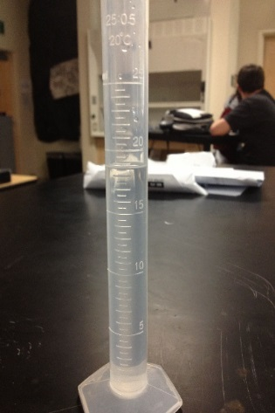
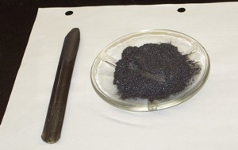
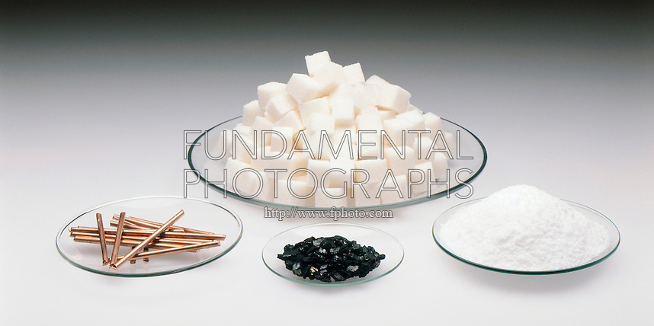
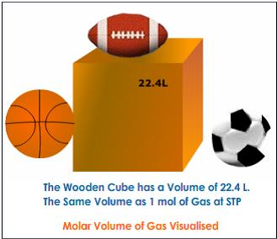
One mole looks like…
One mole of water (18 mL)
One mole of carbon (12 g)
One mole of sugar (342 g)
One mole of salt (58 g)
One mole of copper (64 g)
One mole of any gas = 22.4 L

Slide 4
Number – Mole conversions
For any given substance, there is an equivalence between the number of items and 1 mole of the substance:
1 mole of X = 6.022 x 10²³ of X
From this two conversion factors can be written:

Slide 5
Sample number-mol conversions
Ex: How many Cu atoms are there in 1.35 mol Cu?
$1.35 \text{mol} \text{Cu}∙\frac{6.022×{10}^{23}\text{Cu} \text{atoms}}{1 \text{mol} \text{Cu}}=$ 8.13 x 10²³ Cu atoms
Ex: How many CO ₂ molecules are there in 0.375 mol CO₂?
$0.375 \text{m}\text{o}\text{l} \text{C}{\text{O}}_{\text{2}}∙\frac{6.022×{10}^{23}\text{C}{\text{O}}_{\text{2}}\text{molecules}}{1 \text{mol} \text{C}{\text{O}}_{\text{2}}}$ = 2.26 x 10²³ molecules
Ex: 7.05 x 10³⁵ Au atoms makes how many moles of Au?
$\text{7.05 }\text{x}\text{ 1035 }\text{Au} \text{atoms}∙\frac{1 \text{mol} \text{Au}}{6.022×{10}^{23}\text{Au} \text{atom}s}=$ 1.17x10¹² mol Au

Slide 6
Molar Mass
The mass of a mole of atoms or molecules is called its molar mass.
Because 1 mole of 1 amu = 1 g Molar mass in grams = formula mass in amu.
Already know how to find formula mass (add up average atomic mass for each atom in a chemical formula).
Simply change unit to grams to find the molar mass.
Find the molar mass of Al₂O₃ and Al₂(SO₄)₃ using your periodic table.

Slide 7
Gram – Mole conversions
For any given substance, there is an equivalence between its molar mass and 1 mole of the substance:
1 mole of X = (molar mass of X) grams
From this two conversion factors can be written:

Slide 8
Sample g-mol conversions
Ex: What is the mass of 3.50 mol of NaCl?
$3.50 \text{m}\text{o}\text{l} \text{NaCl}∙\frac{58.44 \text{g} \text{NaCl}}{\text{1} \text{mol} \text{NaCl}}$ = 204 g NaCl
Ex: How many moles of Al(OH)₃ are in a 75.8 g sample?
$75.8 g \text{Al}\text{ (}\text{OH}{\text{)}}_{\text{3}}∙\frac{ 1 \text{mol} \text{Al}\text{ (}\text{OH}{\text{)}}_{\text{3}}}{\text{78.003} \text{g} \text{Al}\text{ (}\text{OH}{\text{)}}_{\text{3}}}$ = 0.972 mol Al(OH)₃

Slide 9
Mole – volume conversions
For any gas, the volume occupied by one mole is 22.4 L at STP
1 mole of gas = 22.4 L
From this two conversion factors can be written:

Slide 10
Sample Volume-mol conversions
Ex: What is the volume of 3.50 mol of O₂ at STP?
$3.50 mol {\text{O}}_{\text{2}}∙\frac{ \text{22.4 }\text{L} {\text{O}}_{\text{2}}}{1 \text{mol} {\text{O}}_{\text{2}}}$ = 78.4 L O₂
Ex: How many moles of He are in a 647 L balloon at STP?
$647 \text{L} \text{He}∙\frac{ 1 \text{mol} \text{He}}{22.4 \text{L} \text{He}}$ = 28.9 mol He

Slide 11
Mixed practice and Multistep
How many moles of NaOH are present in 5.68 g of NaOH?
How many carbon atoms are there in a 2.35 g diamond?
What is the mass of 3.50 moles of ethanol, C₂H₅OH?
Hint: These two are both two step conversions. Apply two fractions with times sign draw the line copy unit. Then calculate.
What is the mass of 1.45 x 10²⁴ atoms of Cu?
What is the volume of 50.0 g of oxygen gas (O₂) at STP?
0.142 mol NaOH
1.42x10²⁴ C atoms
161 g C₂H₅OH
153 g Cu
35.0 L O₂

Slide 12
Assignment
What’s Due? (Pending assignments to complete.)
Mole Conversion worksheet
Reminder: Check the Expectations Excel file posted on the General area files section to make sure you have fulfilled all the expected activities.

